Slide 1
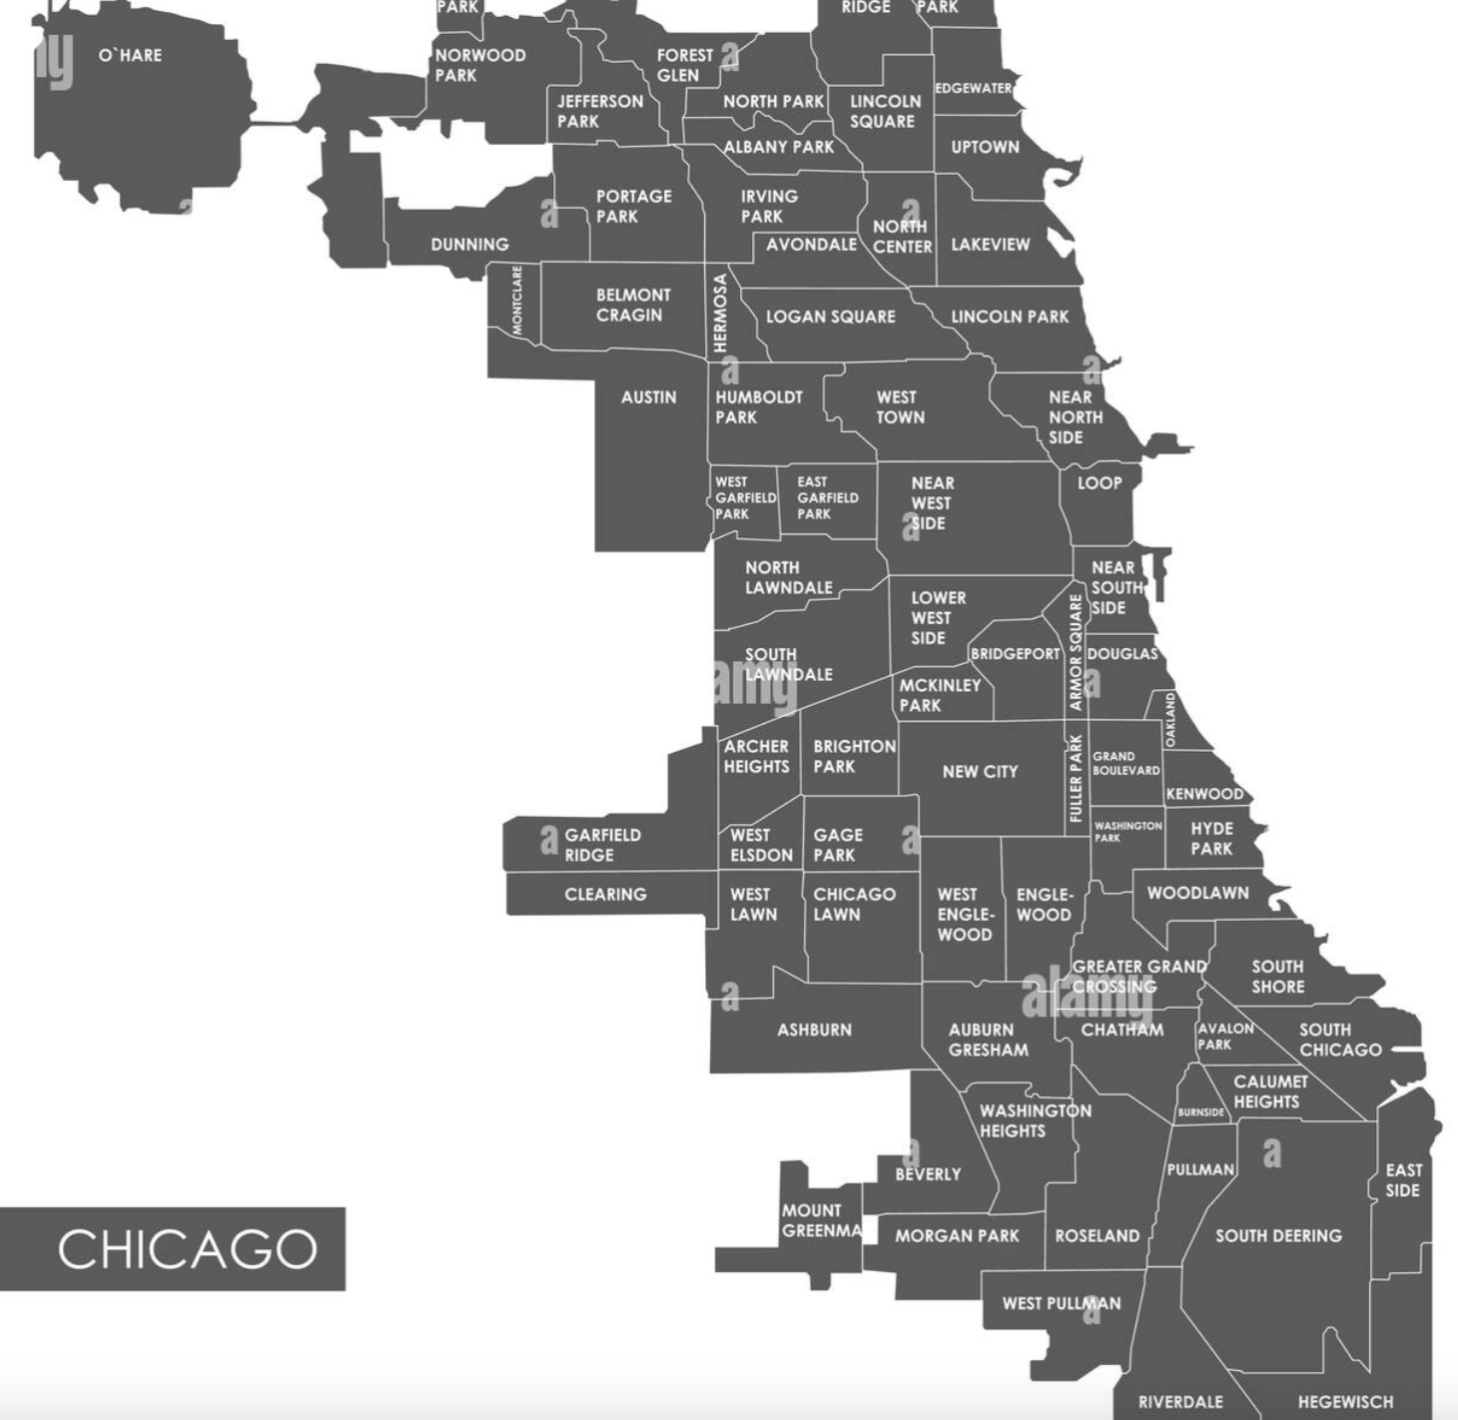
CASE STUDY: How does a bike-share navigate speedy success?
Shumaila Khan
February 2024

Slide 2
Outline
Background information
Business questions
Prepare data for analysis
Process data for analysis

Slide 3
Background on Cyclistic
Bikeshare Company launched in 2016
Currently has fleet of 5,824 bikes and 692 stations throughout Chicagoland
Flexible riding plans: single-ride passes, full-day passes, and annual memberships
Finance has determined that annual members are much more profitable than casual riders
Director of marketing believes maximizing the number of annual members is key to future growth
Design marketing strategies aimed at converting casual riders into annual members

Slide 4
Business Questions to address
Three questions will guide the future marketing program:
How do annual members and casual riders use Cyclistic bikes differently?
Why would casual riders buy Cyclistic annual memberships?
How can Cyclistic use digital media to influence casual riders to become members?
This study will be focusing on the first task

Slide 5
Prepare Data for Analysis
Obtained data made available by Motivate International Inc. at https://divvy-tripdata.s3.amazonaws.com/index.html
Downloaded last 12 months of data from February 2023 to January 2024
Features of the data:
ride_id
rideable_type(electric, docked)
started_at
ended_at
start_station_name
start_station_id
end_station_name
end_station_id
start_lat
start_lng
end_lat
end_lng
member_casual

Slide 6
Process Data for Analysis
Used SQL for processing the data since there’s a little over 5 million records for the one year period
Pulled each table and put all the tables together into one table within SQL
Calculated ride length in minutes for each record and month, day, and year using the ride start timestamp
Cleaning and Verification:
Several ride length times(2.5%) were less than or equal to zero since start time was earlier then end time; these data points were removed
Ensure that there is no NULL data for the member/casual classifiction

Slide 7
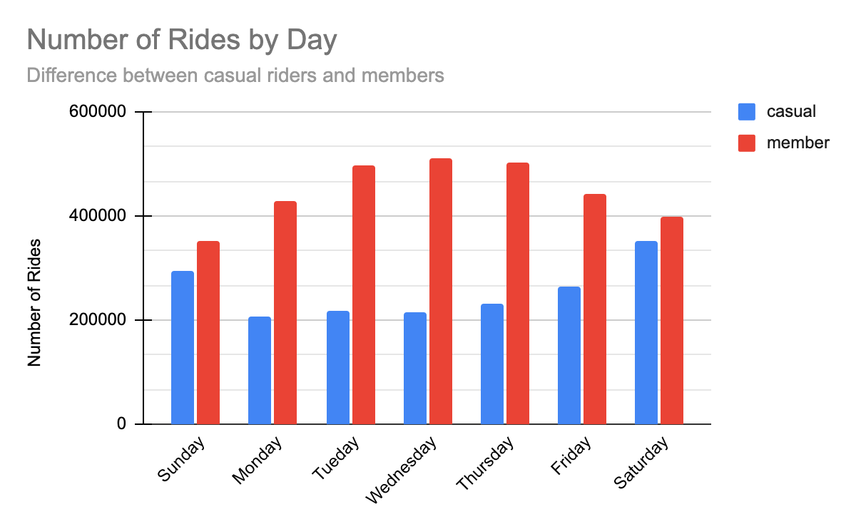
Analysis by Day of the WEEK
Members ride more frequently than casual members on all days of the week
Difference is lesser on the weekends
Casual riders ride most frequently on the weekends

Slide 8
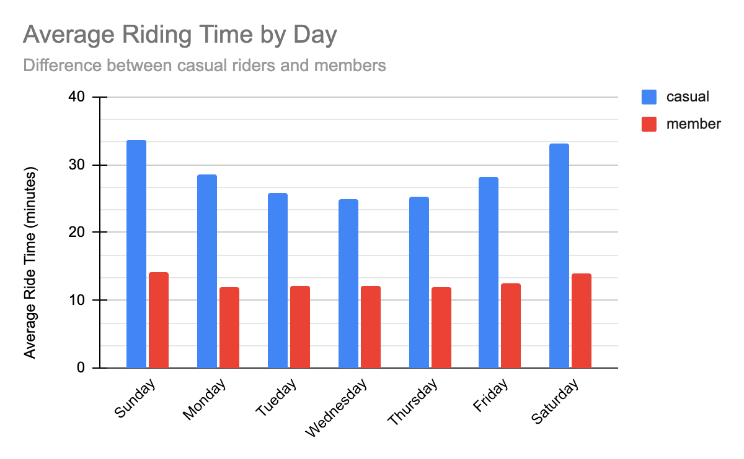
Analysis by day of the week
Average riding time for casual riders is higher then members on all days of the week
Highest riding averages for both members and casual riders are on the weekends

Slide 9
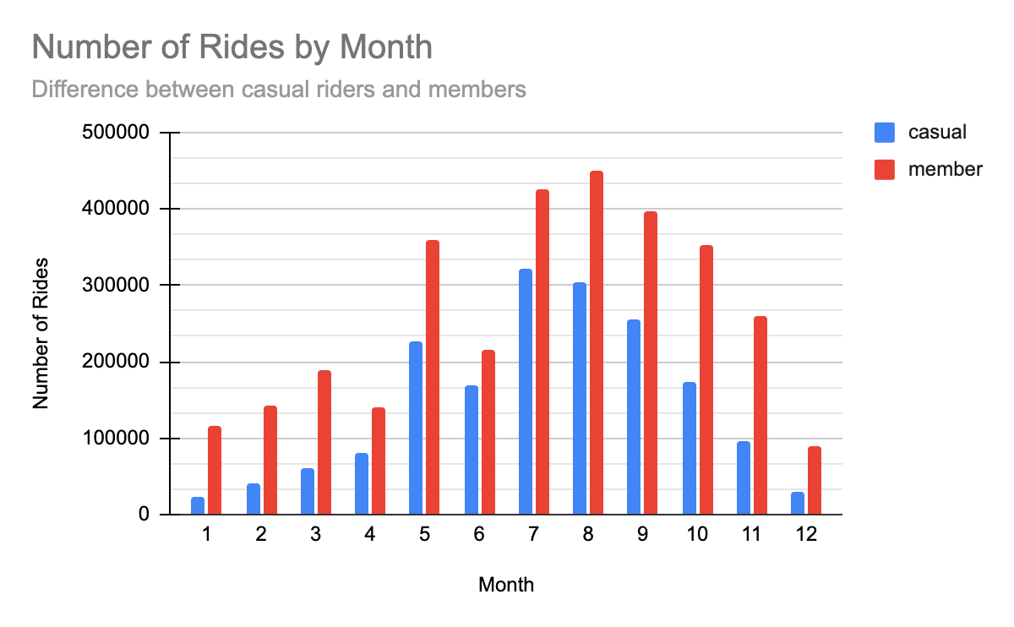
ANALYSIS by Month
There’s an increase in ridership of members and casual riders in the summer and fall months
There is significantly small number of rides by casual riders in the winter months

Slide 10
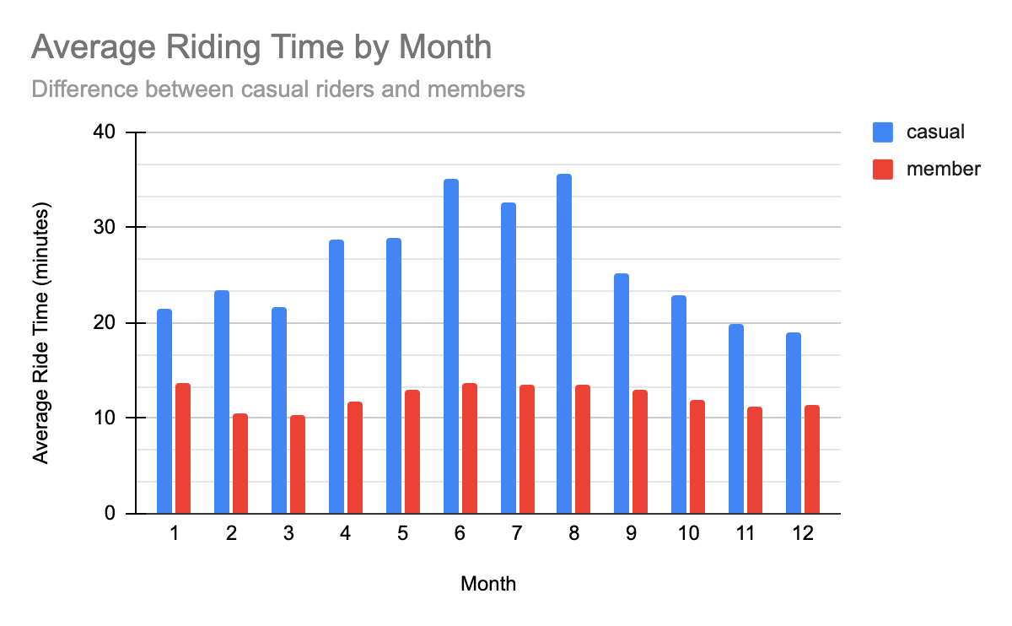
ANAlysis by Month
Casual riders have a higher average ride time in the summer months
Casual riders ride significantly longer times then members

Slide 11
Final analysis recommendations
Casual riders ride most frequently on:
the weekends
in the summer and fall months
Casual ride minutes do not vary significantly by day or month of the year
Average time casual riders ride is much more then members

